Slide 1
Lock Based Protocols
Name :Shiva Kumar
Roll No :- 227R1A05J3
Section: Cse (c)
Database management system

Slide 2
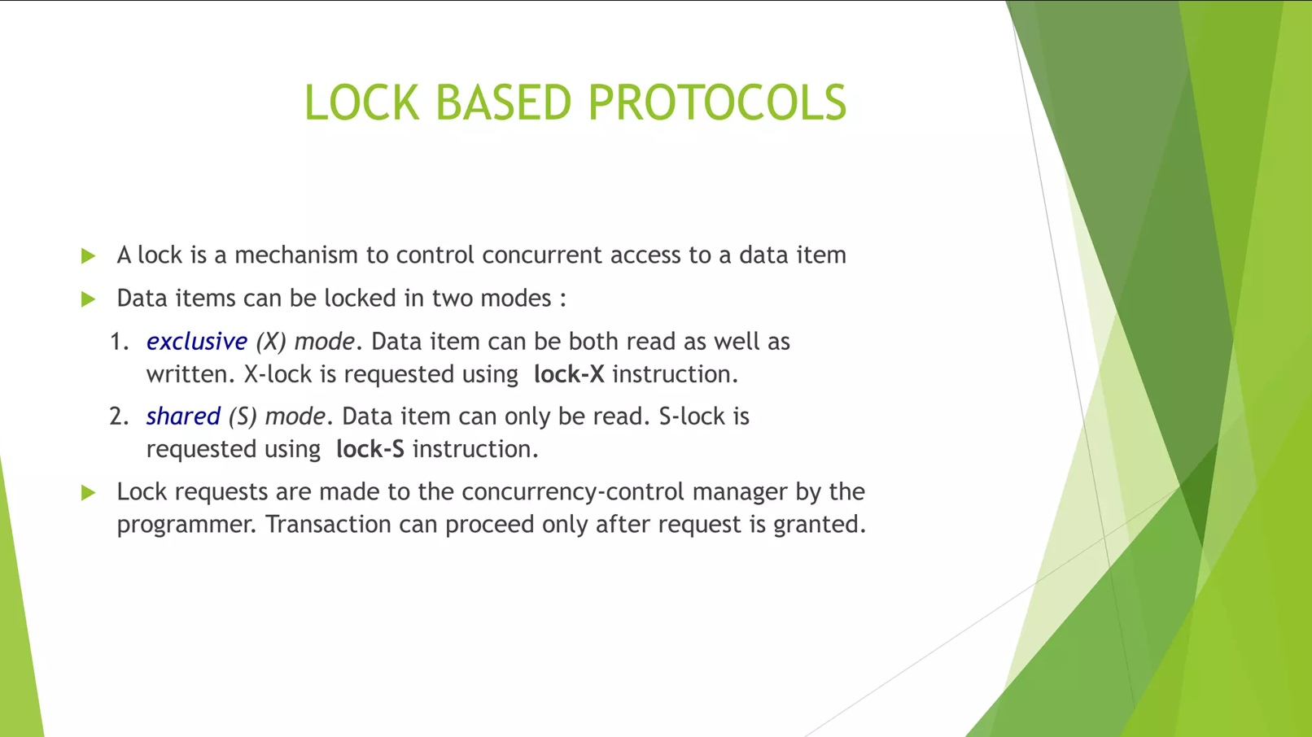

Slide 3
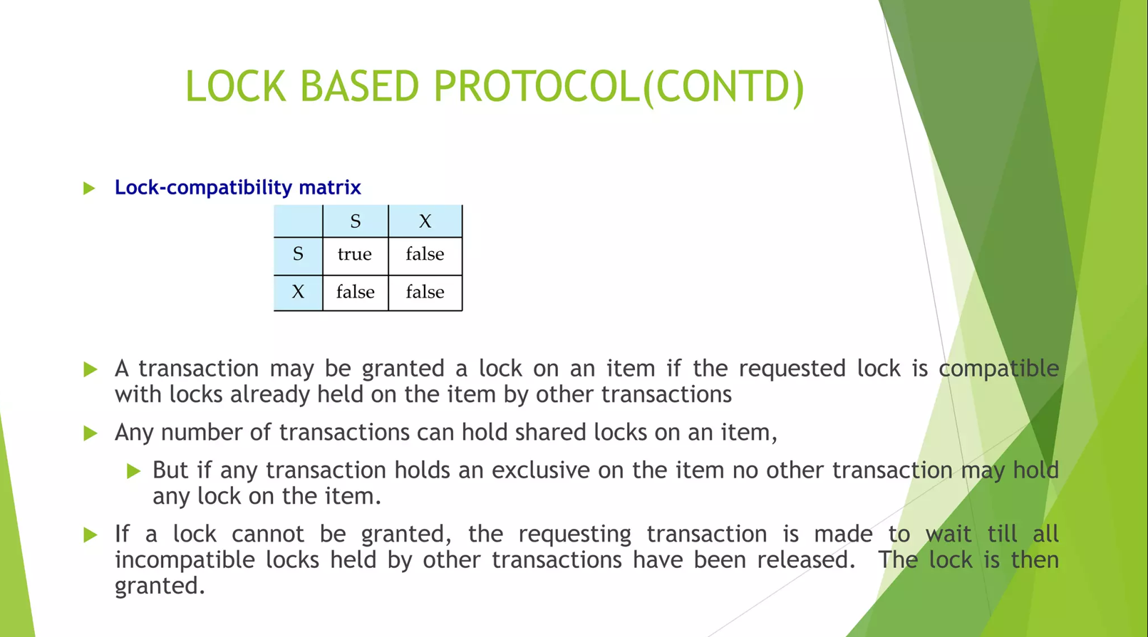

Slide 4
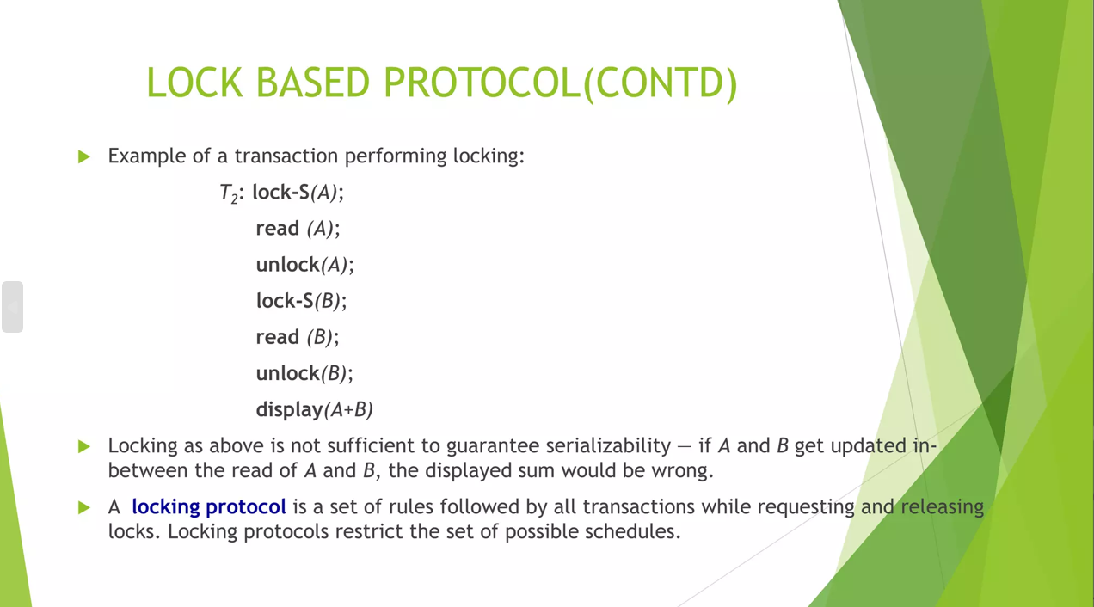

Slide 5
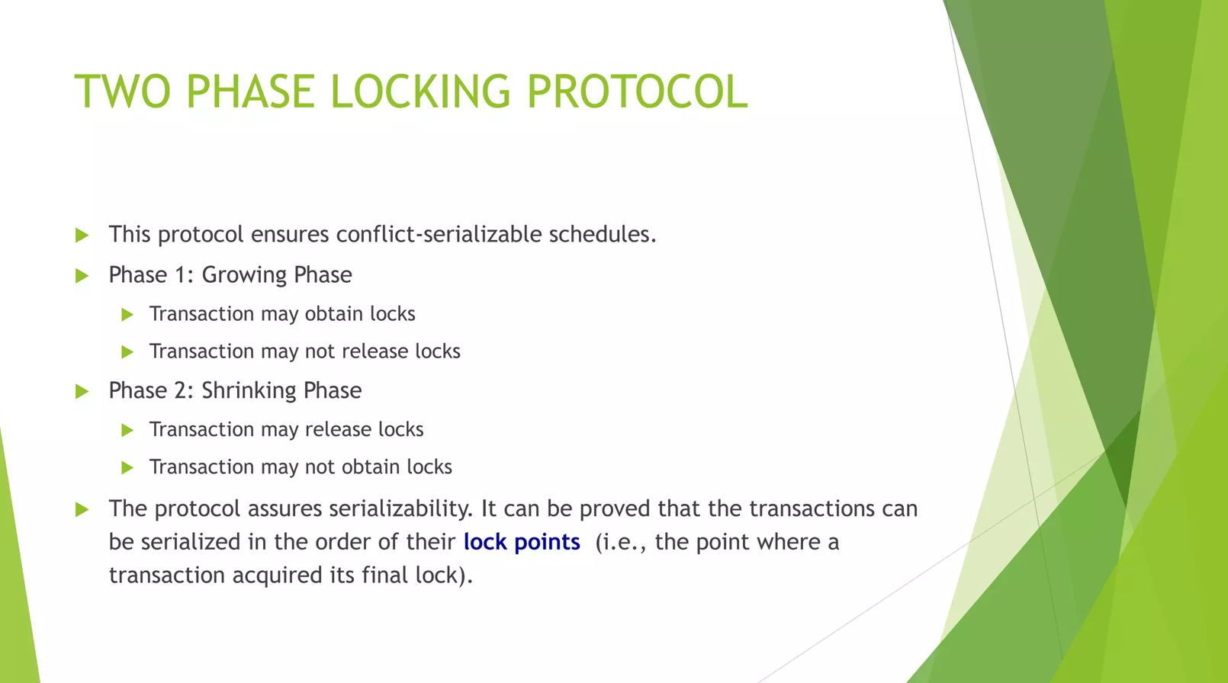

Slide 6
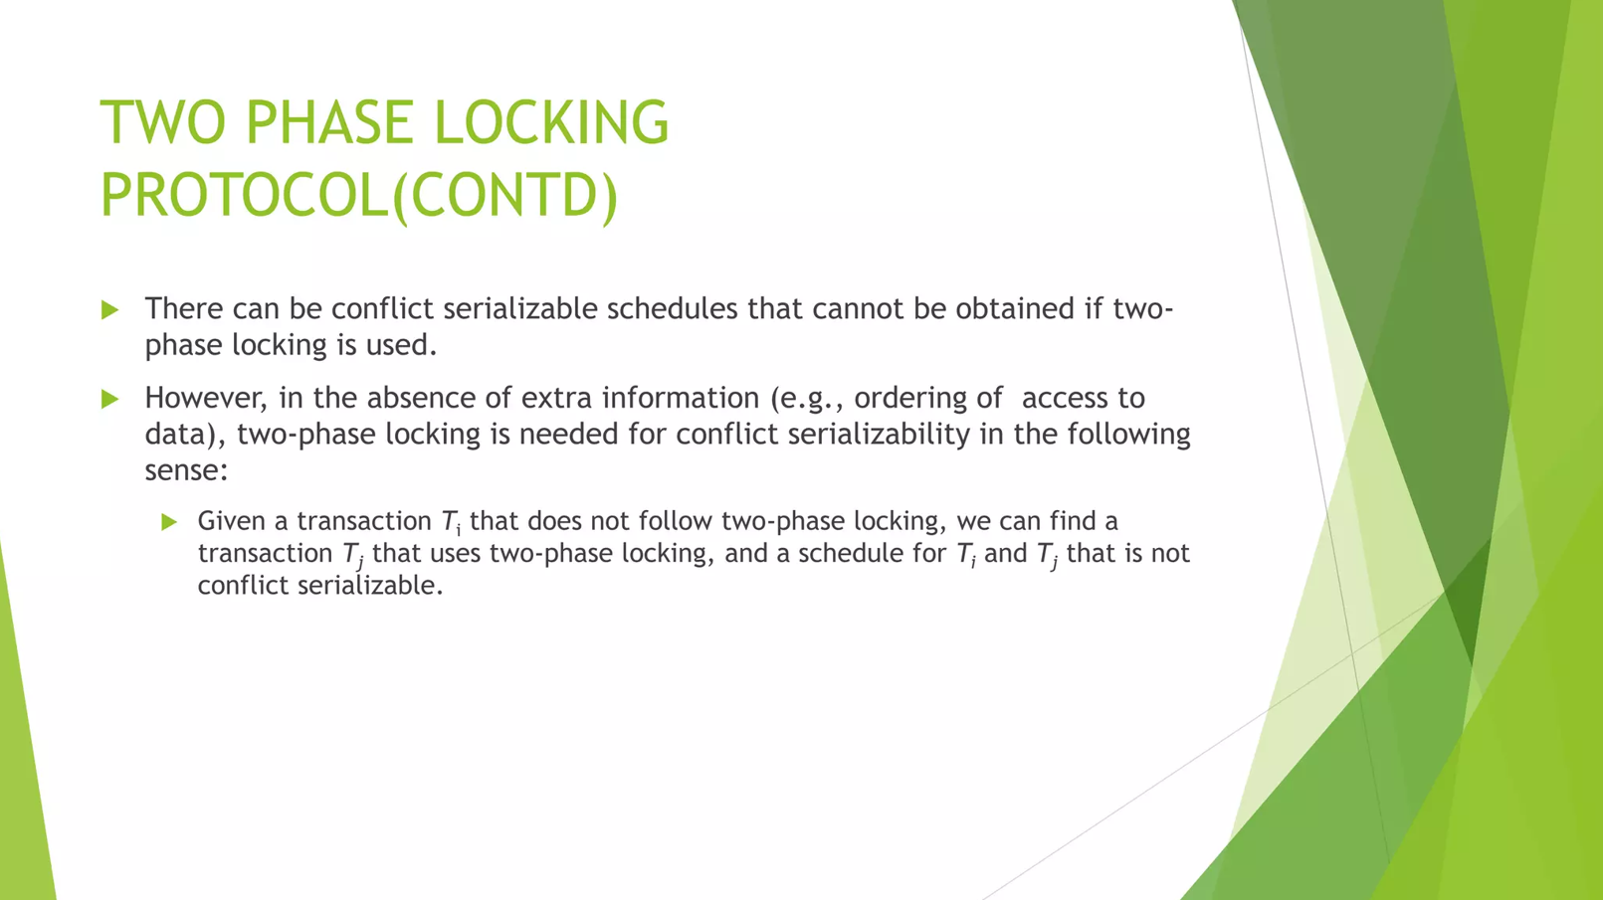

Slide 7


